Slide 1
Parallel Processing
Bill “Master Tier” Kerney

Slide 2
Agenda
Intro
Fork()
#include <thread>
Contention
Mutexes
Deadlock
OpenMP
MPI

Slide 3

Introduction
I graduated in 2000, 2001, and 2002 from UC San Diego with a Master’s Degree in Computer Science with a specialty in High Performance Computing:
Notes:
Yes this is my actual diploma /s

Slide 4

High Performance Computing
High Performance Computing means being able to play with the world’s most expensive computers: supercomputers.
They can run hello world really, really fast.
No, not really. They’re usually just clusters of large numbers of computers tied together on a high speed network.
So in order to play with the Big Iron, you need to learn how to write code that can run on multiple CPUs.
There’s some traps along the way, but that’s what we’re going to learn today. Two hours instead of a semester long class.

Slide 5
Processes
A “process” is what we’d call an “app” in Android or a “program” in Windows. It’s your basic thing you run when you run an executable.
You can type ‘ps’ at the UNIX prompt to see what processes you have running.
ps aux – will show all processes running on the server
Each process has a unique “process id” that identifies it
You can kill your processes with “kill”
‘kill 2710125’ will kill process 2710125
‘kill -9 2710125’ will kill process 2710125 with prejudice

Slide 6
Fork()
The first mechanism of parallel processing is pretty simple. The fork() system call duplicates the current process. Example:
#include <unistd.h>
int main() {
pid_t pid = fork();
if (pid == 0) {} // child process
else if (pid > 0) {} // parent process
else {} // fork failed
}

Slide 8
Wait() / Waitpid()
The wait() function can be used by a parent process to wait for a child to finish.
Easy mode:
wait(0); //Waits for any child to exit
Detailed mode:
int status = 0; //Get return value from child
waitpid(pid,&status,0); //Wait for pid to exit
cout << WEXITSTATUS(status) << endl; //Print retval

Slide 9
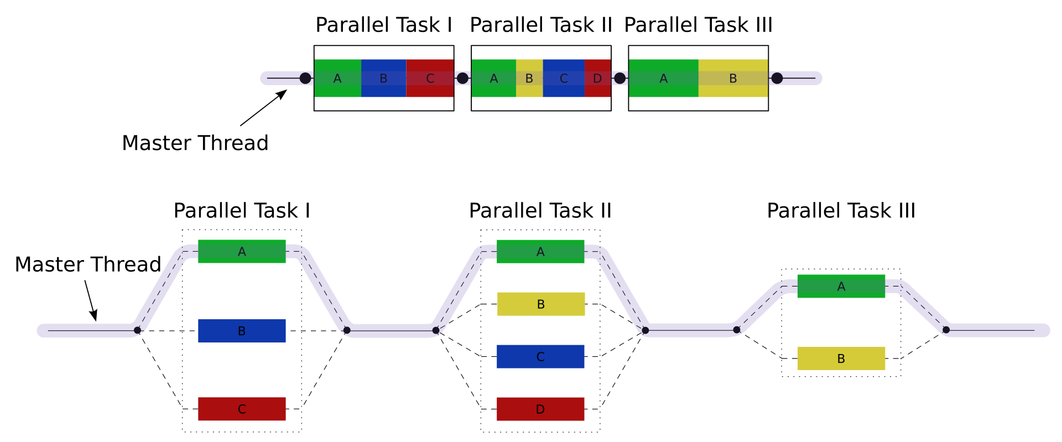
Fork/Join Model
Notes:
https://en.wikipedia.org/wiki/Fork%E2%80%93join_model

Slide 10
IPC
Two processes made from fork don’t have an easy way to communicate with each other, so you need to do something called IPC – interprocess communication
Sockets are probably the most common way of doing this
Networking is a whole different talk
You can also use the pipe() command to read and write to it like a file. One process reads from it, the other writes to it.

Slide 11
#include <thread>
Threads are different flows of execution within one process
Unlike fork()ed processes they share memory
So you can have a global variable or array that everyone can read and write to
Very easy to spawn a thread. If you have a function named foo and you want to run it in its own thread:
thread t(foo); //Runs foo in its own thread
To wait for thread t to finish:
t.join(); //Pauses until foo() is done running

Slide 12
Thread Example
int counter; //Global variable; initialized to 0
void foo() {
for (int i = 0; i < 1'000'000; i++) counter++;
}
int main() {
thread t1(foo); //Spawns thread that runs foo()
thread t2(foo); //Ditto
t1.join(); //Wait for thread1 to finish
t2.join(); //Wait for thread2 to finish
cout << counter << endl; //Will print 2000000
}
Notes:
This only works since ++ is atomic in x86

Slide 13
Shared Memory
What differentiates threads within one process and forking a different process is that threads in a process share memory.
They can all access the same global variables
The trouble is if you are reading and writing to the same variable at the same time, they can step on each other’s feet.
For example, if two threads load a value and then double it, you might get 4x the result. OR if they load at the same time, then you’ll only get 2x the result.
This is very dangerous for program correctness.
Look up #include <atomic> for operations that will work right.

Slide 14
#include <mutex>
Mutex = Mutual Exclusion
If we want to have code that only allows one thread to be in it at a time, we use mutexes. It looks like this:
int x; //Global variable
mutex mtx; //Only one thread can lock mtx
void foo() {
lock_guard<mutex> lock(mtx); //Acquire lock
x = x * 2; //Read and write to x safely
}

Slide 15
Mutexes
When you get to that line with lock_guard, if nobody has the lock, the thread acquires the lock and continues
If the thread does not have the lock, it waits for the lock to be released. Once the lock is freed up, it acquires the lock.
If multiple threads are waiting, they will queue up for the lock, like waiting in line for a restroom.
This will hurt performance, so it’s better to use atomic operations if you can.

Slide 16
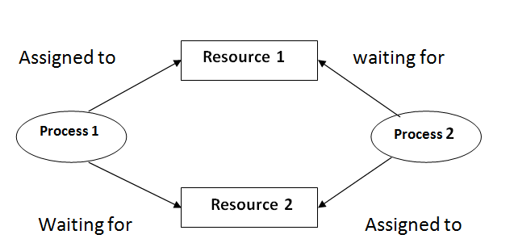
Deadlock
The big danger of locks is that it can freeze your program.
This is why a lot of companies don’t multithread their code.
If thread1 has lock1 and tries to acquire lock2, and thread2 has lock2 and tries to acquire lock1, they will both wait forever.

Slide 17
Deadlock
The easiest way to avoid deadlock is to not structure your code in such a way that it’s possible.
As long as a thread doesn’t try acquiring two locks at a time, it can’t deadlock.
This can be tricky when functions are all calling each other with locks in each one, so you need to sketch out exactly where your locks are

Slide 18
MPI
Learning MPI is a talk in itself, but basically it works like the fork() system of spawning different processes, but the processes are spawned on different computers, possibly over the internet from each other.
They use MPI_Send and MPI_Recv to transmit data to each other, like how fork()ed processes use sockets
Lots of other API calls to help do parallel processing stuff

Slide 19
OpenMP
Finally, let’s talk about OpenMP. With OpenMP, you can just write your code normally, and tell the processor to run your code in parallel:
#pragma OMP parallel for
for (int i = 0; i < 100000; i++) x += i;
This will automatically spawn off multiple threads to attack the loop at the same time.
It’s literally the easiest way to parallelize code.
If you get into it, there are more options you can set.

